Slide 1




Statistical Methods for
Estimating Abundance in Ecology

Slide 2
Estimating Abundance – Closed Population Estimation
1. Question
2. Field Data
3. Format Data for Analysis
4. Fit Population Model
5. Examine Output and Visualize Results
*steps 3-5 in Program R

Slide 3

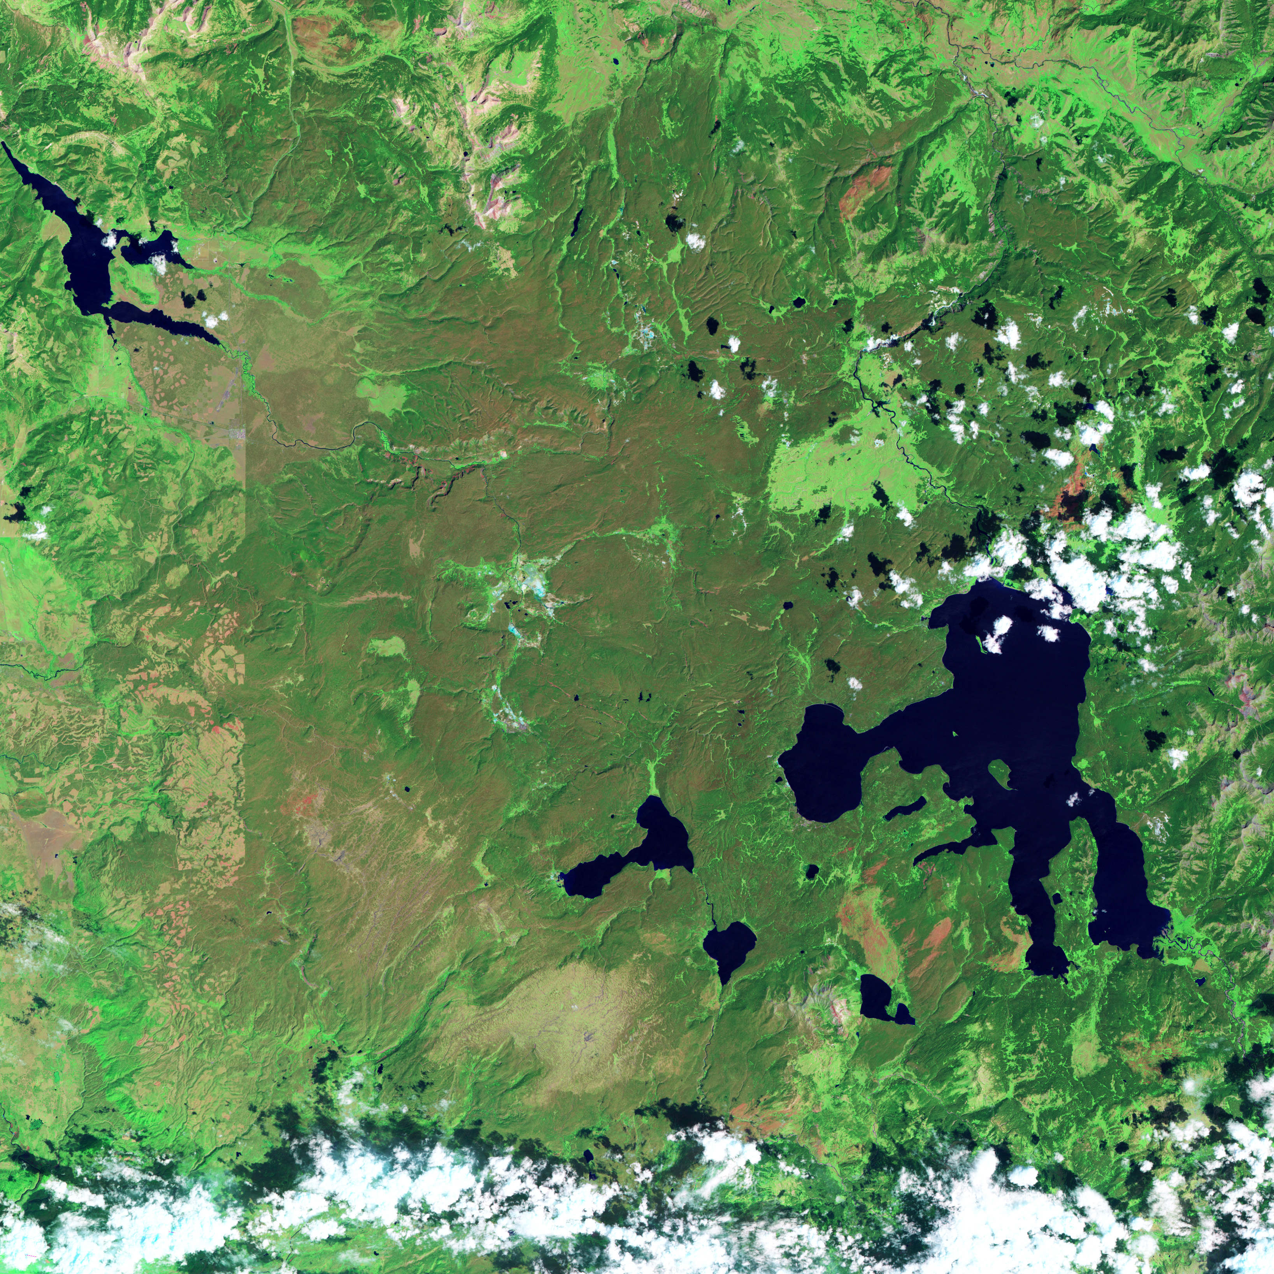
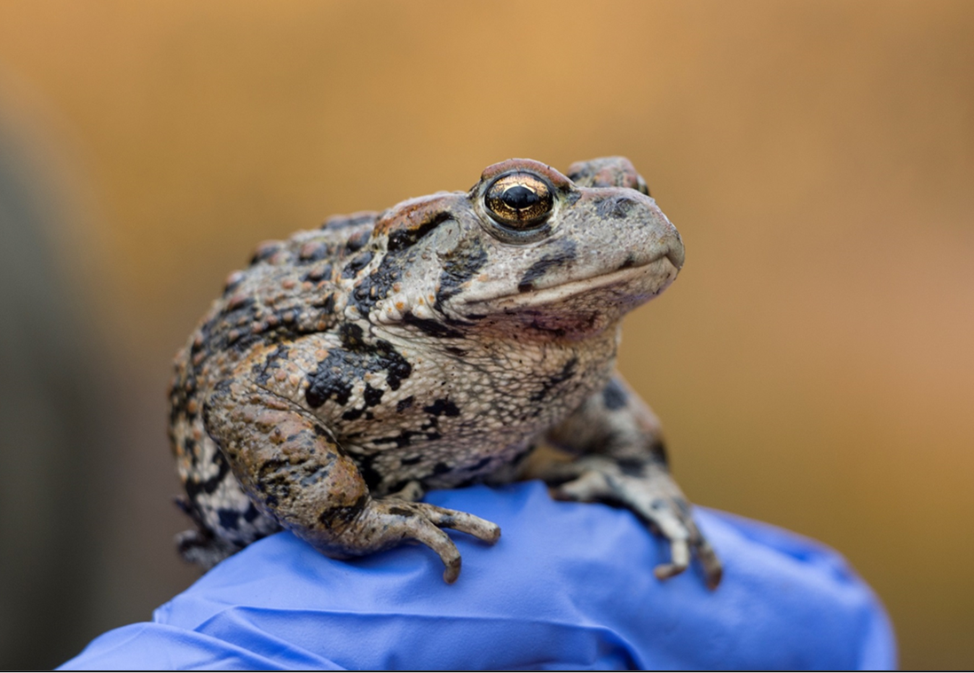
Estimating Abundance – Closed Population Estimation
1. Question
How does boreal toad abundance vary across ponds?
x
J. Grant

Slide 4
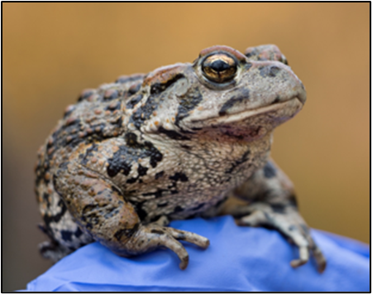
Estimating Abundance – Closed Population Estimation
1. Question
How does boreal toad abundance vary across ponds?
Date | Pond | Survey | SVL | Tag

Slide 5
Estimating Abundance – Closed Population Estimation
1. Question
How does boreal toad abundance vary across ponds?
Date | Pond | Survey | SVL | Tag
5/29/2015 | 1 | 1

Slide 6
Estimating Abundance – Closed Population Estimation
1. Question
How does boreal toad abundance vary across ponds?
Date | Pond | Survey | SVL | Tag
5/29/2015 | 1 | 1 | 65

Slide 7
Estimating Abundance – Closed Population Estimation
1. Question
How does boreal toad abundance vary across ponds?
Date | Pond | Survey | SVL | Tag
5/29/2015 | 1 | 1 | 65 | 100

Slide 8
Estimating Abundance – Closed Population Estimation
1. Question
How does boreal toad abundance vary across ponds?
Date | Pond | Survey | SVL | Tag
5/29/2015 | 1 | 1 | 65 | 100
5/29/2015 | 1 | 1 | 75 | 101
5/29/2015 | 1 | 1 | 68 | 102
5/29/2015 | 1 | 1 | 80 | 103
5/29/2015 | 1 | 1 | 60 | 104
5/29/2015 | 1 | 1 | 89 | 105
5/29/2015 | 1 | 1 | 82 | 106

Slide 9
Estimating Abundance – Closed Population Estimation
1. Question
How does boreal toad abundance vary across ponds?
Date | Pond | Survey | SVL | Tag
5/29/2015 | 1 | 1 | 65 | 100
5/29/2015 | 1 | 1 | 75 | 101
5/29/2015 | 1 | 1 | 68 | 102
5/29/2015 | 1 | 1 | 80 | 103
5/29/2015 | 1 | 1 | 60 | 104
5/29/2015 | 1 | 1 | 89 | 105
5/29/2015 | 1 | 1 | 82 | 106
6/1/2015 | 1 | 2

Slide 10
Estimating Abundance – Closed Population Estimation
1. Question
How does boreal toad abundance vary across ponds?
Date | Pond | Survey | SVL | Tag
5/29/2015 | 1 | 1 | 65 | 100
5/29/2015 | 1 | 1 | 75 | 101
5/29/2015 | 1 | 1 | 68 | 102
5/29/2015 | 1 | 1 | 80 | 103
5/29/2015 | 1 | 1 | 60 | 104
5/29/2015 | 1 | 1 | 89 | 105
5/29/2015 | 1 | 1 | 82 | 106
6/1/2015 | 1 | 2 | 58

Slide 11
Estimating Abundance – Closed Population Estimation
1. Question
How does boreal toad abundance vary across ponds?
Date | Pond | Survey | SVL | Tag
5/29/2015 | 1 | 1 | 65 | 100
5/29/2015 | 1 | 1 | 75 | 101
5/29/2015 | 1 | 1 | 68 | 102
5/29/2015 | 1 | 1 | 80 | 103
5/29/2015 | 1 | 1 | 60 | 104
5/29/2015 | 1 | 1 | 89 | 105
5/29/2015 | 1 | 1 | 82 | 106
6/1/2015 | 1 | 2 | 58 | 107

Slide 12
Estimating Abundance – Closed Population Estimation
1. Question
How does boreal toad abundance vary across ponds?
Date | Pond | Survey | SVL | Tag
5/29/2015 | 1 | 1 | 65 | 100
5/29/2015 | 1 | 1 | 75 | 101
5/29/2015 | 1 | 1 | 68 | 102
5/29/2015 | 1 | 1 | 80 | 103
5/29/2015 | 1 | 1 | 60 | 104
5/29/2015 | 1 | 1 | 89 | 105
5/29/2015 | 1 | 1 | 82 | 106
6/1/2015 | 1 | 2 | 58 | 107
6/1/2015 | 1 | 2 | 68

Slide 13
Estimating Abundance – Closed Population Estimation
1. Question
How does boreal toad abundance vary across ponds?
Date | Pond | Survey | SVL | Tag
5/29/2015 | 1 | 1 | 65 | 100
5/29/2015 | 1 | 1 | 75 | 101
5/29/2015 | 1 | 1 | 68 | 102
5/29/2015 | 1 | 1 | 80 | 103
5/29/2015 | 1 | 1 | 60 | 104
5/29/2015 | 1 | 1 | 89 | 105
5/29/2015 | 1 | 1 | 82 | 106
6/1/2015 | 1 | 2 | 58 | 107
6/1/2015 | 1 | 2 | 68 | 102

Slide 14
Estimating Abundance – Closed Population Estimation
1. Question
How does boreal toad abundance vary across ponds?
Date | Pond | Survey | SVL | Tag
5/29/2015 | 1 | 1 | 65 | 100
5/29/2015 | 1 | 1 | 75 | 101
5/29/2015 | 1 | 1 | 68 | 102
5/29/2015 | 1 | 1 | 80 | 103
5/29/2015 | 1 | 1 | 60 | 104
5/29/2015 | 1 | 1 | 89 | 105
5/29/2015 | 1 | 1 | 82 | 106
6/1/2015 | 1 | 2 | 58 | 107
6/1/2015 | 1 | 2 | 68 | 102
6/1/2015 | 1 | 2 | 76 | 108
6/1/2015 | 1 | 2 | 75 | 101
6/1/2015 | 1 | 2 | 67 | 109
6/1/2015 | 1 | 2 | 81 | 110

Slide 15
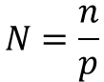
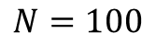
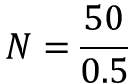
Estimating Abundance – Closed Population Estimation
$$Population size= \frac{\# of individuals marked}{probability of capturing an individual at least once}$$
$$N=\frac{n}{p}$$
$$N=\frac{50}{0.5}$$
$$N=100$$

Slide 16
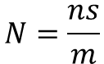
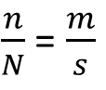
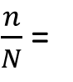
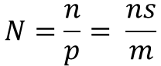
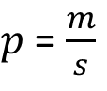
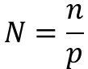
Estimating Abundance – Closed Population Estimation
$$Population size= \frac{\# of individuals marked}{probability of capturing an individual at least once}$$
$$N=\frac{n}{p}$$
$$N=\frac{50}{0.5}$$
$$N=100$$
$\frac{n}{N}$ =
$\frac{n}{N}$ = $\frac{m}{s}$
$$N=\frac{ns}{m}$$
$$N=\frac{n}{p}$$
$p$ = $\frac{m}{s}$
$$N=\frac{n}{p}= \frac{ns}{m}$$

Slide 17

Estimating Abundance – Closed Population Estimation
$$Population size= \frac{\# of individuals marked}{probability of capturing an individual at least once}$$
$$N=\frac{n}{p}$$
$$N=\frac{50}{0.5}$$
$$N=100$$
$\frac{n}{N}$ =
$\frac{n}{N}$ = $\frac{m}{s}$
$$N=\frac{ns}{m}$$
$$N=\frac{n}{p}$$
$p$ = $\frac{m}{s}$
$$N=\frac{n}{p}= \frac{ns}{m}$$

Slide 18
Estimating Abundance – Closed Population Estimation
$$Population size= \frac{\# of individuals marked}{probability of capturing an individual at least once}$$
$$N=\frac{n}{p}$$
$$N=\frac{50}{0.5}$$
$$N=100$$
$\frac{n}{N}$ =
$\frac{n}{N}$ = $\frac{m}{s}$
$$N=\frac{ns}{m}$$
$$N=\frac{n}{p}$$
$p$ = $\frac{m}{s}$
$$N=\frac{n}{p}= \frac{ns}{m}$$

Slide 19
Estimating Abundance – Closed Population Estimation
$$Population size= \frac{\# of individuals marked}{probability of capturing an individual at least once}$$
$$N=\frac{n}{p}$$
$$N=\frac{50}{0.5}$$
$$N=100$$
$\frac{n}{N}$ =
$\frac{n}{N}$ = $\frac{m}{s}$
$$N=\frac{ns}{m}$$
$$N=\frac{n}{p}$$
$p$ = $\frac{m}{s}$
$$N=\frac{n}{p}= \frac{ns}{m}$$

Slide 20
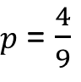
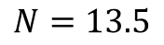
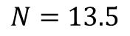
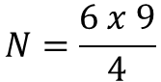
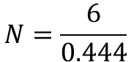
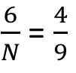
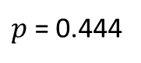
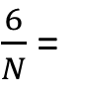
Estimating Abundance – Closed Population Estimation
$$Population size= \frac{\# of individuals marked}{probability of capturing an individual at least once}$$
$$N=\frac{n}{p}$$
$$N=\frac{50}{0.5}$$
$$N=100$$
$\frac{n}{N}$ =
$\frac{n}{N}$ = $\frac{m}{s}$
$$N=\frac{ns}{m}$$
$$N=\frac{n}{p}$$
$p$ = $\frac{m}{s}$
$$N=\frac{n}{p}= \frac{ns}{m}$$
$\frac{6}{N}$ =
$\frac{6}{N}$ = $\frac{4}{9}$
$$N=\frac{6 x 9}{4}$$
$p$ = $\frac{4}{9}$
$$N=\frac{6}{0.444}$$
$$N=13.5$$
$$N=13.5$$
$p$ = 0.444

Slide 21
Estimating Abundance – Closed Population Estimation
1. Question
How does boreal toad abundance vary across ponds?
Date | Pond | Survey | SVL | Tag
5/29/2015 | 1 | 1 | 65 | 100
5/29/2015 | 1 | 1 | 75 | 101
5/29/2015 | 1 | 1 | 68 | 102
5/29/2015 | 1 | 1 | 80 | 103
5/29/2015 | 1 | 1 | 60 | 104
5/29/2015 | 1 | 1 | 89 | 105
5/29/2015 | 1 | 1 | 82 | 106
6/1/2015 | 1 | 2 | 58 | 107
6/1/2015 | 1 | 2 | 68 | 102
6/1/2015 | 1 | 2 | 76 | 108
6/1/2015 | 1 | 2 | 75 | 101
6/1/2015 | 1 | 2 | 67 | 109
6/1/2015 | 1 | 2 | 81 | 110

Slide 22
Estimating Abundance – Closed Population Estimation
R Script: Day3-CaptureRecapture_RMark
Breakout rooms: one person in group will volunteer to share screen
Work through the code: answer each question as a group
Instructors will be available to help you along

Slide 23
Estimating Abundance – Closed Population Estimation
Group 1:
What are individual capture histories?
Compare these two capture histories in your response: 10010 vs 01101
Why were there twelve rows in the design data for capture probability?
Group 2:
What is f0? How did the ‘Closed’ model use f0 to derive abundance estimates?
Did the predicted abundance of boreal toads vary across ponds? How so?
Group 3:
Describe the relationship between time of day and salamander detection…
What is the mean predicted detection probability for surveys conducted at 10am?

Slide 24
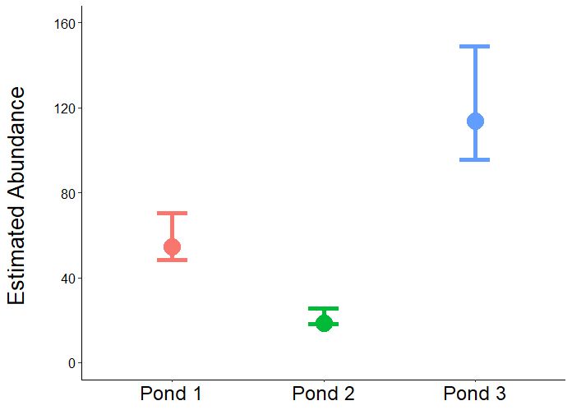
Estimating Abundance – Closed Population Estimation
1. Question
How does boreal toad abundance vary across ponds?
1
2
3

Slide 25
Estimating Abundance – Closed Population Estimation
Group 1:
What are individual capture histories?
Compare these two capture histories in your response: 10010 vs 01101
Why were there twelve rows in the design data for capture probability?
Group 2:
What is f0? How did the ‘Closed’ model use f0 to derive abundance estimates?
Did the predicted abundance of boreal toads vary across ponds? How so?
Group 3:
Which pond had the highest capture probability? The lowest?
Did capture probability vary over time?
Why might capture probability differ among ponds?

Slide 26
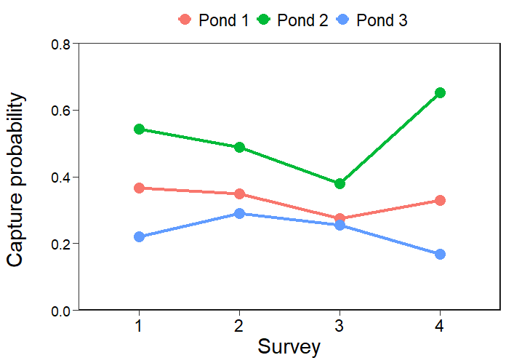
Estimating Abundance – Closed Population Estimation
1. Question
How does boreal toad abundance vary across ponds?
1
2
3

Slide 27
Estimating Abundance – Closed Population Estimation
Group 1:
What are individual capture histories?
Compare these two capture histories in your response: 10010 vs 01101
Why were there twelve rows in the design data for capture probability?
Group 2:
What is f0? How did the ‘Closed’ model use f0 to derive abundance estimates?
Did the predicted abundance of boreal toads vary across ponds? How so?
Group 3:
Which pond had the highest capture probability? The lowest?
Did capture probability vary over time?
Why might capture probability differ among ponds?

Slide 28
Estimating Abundance – Closed Population Estimation
Any questions?
Does anyone want to go over anything again?

Slide 29
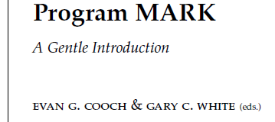



Estimating Abundance – Closed Population Estimation

Slide 30
Estimating Abundance – Closed Population Estimation
Session on Monday (12/6)
Instructors will be available to help with:
Any questions you have
Working through issues with your own data
More complex examples of estimating abundance
Just to chat about life

